Slide 1

Modern Programming Tools And Techniques-I I/O Basics and Streams

Slide 2
Introduction
Most real applications of Java are not text-based, console programs.
Java’s support for console I/O is limited.
Text-based console I/O is not very important to Java programming.
Java provides strong, flexible support for I/O as it relates to files and networks.

Slide 3
Streams
Java implements streams within class hierarchies defined in the java.io package.
A stream is a sequence of data.
A stream is linked to a physical device by the Java I/O system.
All streams behave in the same manner, even if the actual physical devices to which they are linked differ.
An I/O Stream represents an input source or an output destination.

Slide 4
I/O Streams
A stream can represent many different kinds of sources and destinations
– disk files, devices, other programs, a network socket, and memory
Streams support many different kinds of data
– simple bytes, primitive data types, characters, and objects
Some streams simply pass on data; others manipulate and transform the data in useful ways.

Slide 5
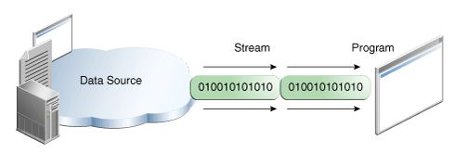
Input Stream
A program uses an input stream to read data from a source, one item at a time.
Reading information into a program.

Slide 6
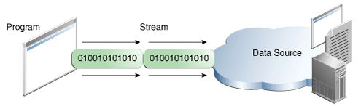
Output Stream
A program uses an output stream to write data to a destination, one item at time:
Writing information from a program.

Slide 7
Types of Streams
Java defines two different types of Streams-
Byte Streams
Character Streams
Byte streams provide a convenient means for handling input and output of bytes.
Byte streams are used, for example, when reading or writing binary data.
Character streams provide a convenient means for handling input and output of characters.
In some cases, character streams are more efficient than byte streams.

Slide 8
Byte Streams
Programs use byte streams to perform input and output of 8-bit bytes.
Byte streams are defined by using two class hierarchies.
At the top, there are two abstract classes: InputStream and OutputStream.
The abstract classes InputStream and OutputStream define several key methods that the other stream classes implement.
Two of the most important methods are read( )and write( ), which, respectively, read and write bytes of data.
Both methods are declared as abstract inside InputStream and OutputStream.

Slide 9
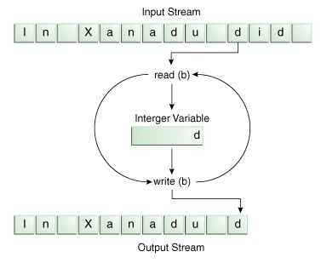
Reading/ Writing File using Streams

Slide 10
Byte Stream Contd…
Note: read() returns an int value.
Using a int as a return type allows read() to use -1 to indicate that it has reached the end of the stream.

Slide 11
Byte Stream Classes
Stream Class | Meaning
BufferedInputStream | Buffered input stream
BufferedOutputStream | Buffered output stream
ByteArrayInputStream | Input stream that reads from a byte array
ByteArrayOutputStream | Output stream that writes to a byte array
DataInputStream | An input stream that contains methods for reading standard data types
DataOutputStream | An output stream that contains methods for writing standard data types
PrintStream | Output stream that contains print( ) and println( )

Slide 12
Use of Byte Stream
Byte streams should only be used for the most primitive I/O.
Byte Stream represents a kind of low-level I/O.
So why talk about byte streams?
Because all other stream types are built on byte streams.

Slide 13
Character Streams
Character streams provide a convenient means for handling input and output of characters.
Character streams are defined by using two class hierarchies.
At the top are two abstract classes, Reader and Writer.
These abstract classes handle Unicode character streams.
The abstract classes Reader and Writer define several key methods that the other stream classes implement.
Two of the most important methods are read( ) and write( ), which read and write characters of data, respectively.

Slide 14
Character Stream Classes
Stream Class | Meaning
BufferedReader | Buffered input character stream
BufferedWriter | Buffered output character stream
CharArrayReader | Input stream that reads from a character array
CharArrayWriter | Output stream that writes to a character array
FileReader | Input stream that reads from a file
FileWriter | Output stream that writes to a file
PrintWriter | Output stream that contains print( ) and println( )
Reader | Abstract class that describes character stream input
Writer | Abstract class that describes character stream output

Slide 15
Predefined Streams
java.lang package defines a class→System
System
encapsulates several aspects of JRE.
Contains 3 stream variables- in, out and err.
These are declared as public and static.
Hence, they can be used by any part of our program without reference to an object of System class.

Slide 16
Standard Input, accessed through System.in;
Standard Output, accessed through System.out;
Standard Error, accessed through System.err.
Standard Output and Standard Error are both for output.
System.in is an object of type InputStream;
System.out and System.err are objects of type PrintStream.

Slide 17
Buffered Streams
Buffered input streams read data from a memory area known as a buffer.
Similarly, buffered output streams write data to a buffer.

Slide 18
BufferedReader
BufferedReader reads text from a character-input stream, buffering characters so as to provide for the efficient reading of characters, arrays, and lines.
public class BufferedReader extends Reader

Slide 19
Reading Console Input
Console input is accomplished by reading from System.in.
To obtain a character-based stream that is attached to the console, wrap System.in in a BufferedReader object.
BufferedReader(Reader inputReader)
Reader is an abstract class. One of its concrete subclasses is InputStreamReader, which converts bytes to characters.
InputStreamReader(InputStream inputStream)

Slide 20
System.in refers to an object of type InputStream, it can be used for inputStream.
BufferedReader br = new BufferedReader(new InputStreamReader(System.in));

Slide 21
Reading Characters
read( ) method is used to read a character from a BufferedReader.
int read( ) throws IOException
read( ) reads a character from the input stream and returns it as an integer value.
It returns –1 when the end of the stream is encountered.

Slide 22
import java.io.*;
class BRRead
{public static void main(String args[]) throws IOException
{char c;
BufferedReader br = new BufferedReader(new InputStreamReader(System.in));
System.out.println("Enter characters, 'q' to quit.");
do {
c = (char) br.read();
System.out.println(c);
} while(c != 'q');
}
}

Slide 23
Reading Strings
To read a string from the keyboard, use the version of readLine( ) that is a member of the BufferedReader class.
String readLine( ) throws IOException

Slide 24
import java.io.*;
class BRReadLines
{public static void main(String args[]) throws IOException
{
BufferedReader br = new BufferedReader(new InputStreamReader(System.in));
String str;
System.out.println("Enter lines of text.");
System.out.println("Enter 'stop' to quit.");
do{str = br.readLine();
System.out.println(str);
} while(!str.equals("stop"));
}
}

Slide 25
Writing Console Output
Console output is done with print(), println( )
Defined by PrintStream.
Object type referenced by System.out.
PrintStream is derived from OutputStream.
Implements low-level method write( ) for writing on console.
System.out is a byte stream, still we can use it for simple program

Slide 26
class WriteDemo
{
public static void main(String args[])
{
int b;
b = 'A';
System.out.write(b);
System.out.write('\n');
}
}

Slide 27
Reading and Writing Files
R/W data as bytes from/to a file.
→All files are byte oriented
Can wrap a byte-oriented file stream within a character-based object.
Classes that create byte streams linked to files are-
FileInputStream
FileOutputStream

Slide 28
How to open a file?
Create an object with file name specified in constructor-
FileInputStream(String fileName) throws FileNotFoundException
FileOutputStream(String fileName) throws FileNotFoundException
FileNotFoundException is thrown.
If we create an input stream and that file doesn’t exist.
For output streams, if file cannot be created.
When an output file is opened, any preexisting file by the same name is destroyed.
Before Java 2, FileOutputStream( ) throws IOException when output file couldn’t be created.

Slide 29
read( )
To read data from a file, read( ) can be used defined in FileInputStream.
int read( ) throws IOException
Reads a single byte and returns it as an integer value.
returns –1 for end of the file.

Slide 30
write()
Defined by FileOutputStream.
void write(int byteval) throws IOException
Writes the byte - byteval to the file.
If an error occurs during writing, IOException is thrown.

Slide 31
Byte Stream
import java.io.FileInputStream;
import java.io.FileOutputStream;
import java.io.IOException;
class CopyBytes
{ public static void main(String[] args) throws IOException
{FileInputStream in = null;
FileOutputStream out = null;
try {in = new FileInputStream("in.txt");
out = new FileOutputStream("out1.txt");
int c;
while ((c = in.read()) != -1) { out.write(c);}
}
finally { if (in != null) { in.close();}
if (out != null) { out.close();}
} } }

Slide 32
Closing the Streams
Closing a stream when it's no longer needed is very important.
It is so important that we have used a finally block to guarantee that both streams will be closed even if an error occurs. This practice helps avoid serious resource leaks.
One possible error is that CopyBytes was unable to open one or both files. When that happens, the stream variable corresponding to the file never changes from its initial null value.
That's why CopyBytes makes sure that each stream variable contains an object reference before invoking close.

Slide 33
Character Streams
The FileReader class creates a Reader that you can use to read the contents of a file.
FileReader(String filePath)
FileReader(File fileObj)
FileWriter creates a Writer that you can use to write to a file.
FileWriter(String filePath)
FileWriter(String filePath, boolean append)
FileWriter(File fileObj)
FileWriter(File fileObj, boolean append)

Slide 34
import java.io.FileReader;
import java.io.FileWriter;
import java.io.IOException;
class CopyCharacters
{ public static void main(String[] args) throws IOException
{ FileReader inputStream = null;
FileWriter outputStream = null;
try { inputStream = new FileReader(“in.txt");
outputStream = new FileWriter(“out.txt");
int c;
while ((c = inputStream.read()) != -1)
{ outputStream.write(c); } }
finally { if (inputStream != null)
{ inputStream.close(); }
if (outputStream != null) { outputStream.close(); }
} } }

Slide 35
Character Streams
Copy Characters is very similar to Copy Bytes.
The most important difference is that Copy Characters uses FileReader and FileWriter for input and output in place of FileInputStream and FileOutputStream.
Both Copy Bytes and Copy Characters use an int variable to read to and write from. However, in Copy Characters, the int variable holds a character value.
The character stream uses the byte stream to perform the physical I/O.

Slide 36
Random Access File
It implements the interfaces DataInput and DataOutput, which define the basic I/O methods.
It also implements the Closeable interface.
RandomAccessFile is special because it supports positioning requests within the file.
RandomAccessFile(File fileObj, String access)
throws FileNotFoundException
RandomAccessFile(String filename, String access)
throws FileNotFoundException
“r”, then the file can be read, but not written
“rw”,then the file is opened in read-write mode
“rws”, the file is opened for read-write operations and every change to the file’s data or metadata will be immediately written to the physical device.

Slide 37
The method seek() is used to set the current position of the file pointer within the file:
void seek(long newPos) throws IOException
Here, newPos specifies the new position of the file pointer from the beginning of the file.
After a call to seek( ), the next read or write operation will occur at the new file position.

Slide 38
Serialization
Serialization is the process of writing the state of an object to a byte stream.
This is useful when we want to save the state of our program to a persistent storage area, such as a file.
At a later time, we may restore these objects by using the process of de-serialization.
Serialization is also needed to implement Remote Method Invocation (RMI).

Slide 39
An object to be serialized may have references to other objects, which, in turn, have references to still more objects.
If we attempt to serialize an object at the top of an object graph, all of the other referenced objects are recursively located and serialized.

Slide 40
Serialization: Interfaces and Classes
An overview of the interfaces and classes that support serialization follows:
Serializable
Only an object that implements the Serializable interface can be saved and restored by the serialization facilities.
The Serializable interface defines no members.
It is simply used to indicate that a class may be serialized.
If a class is serializable, all of its subclasses are also serializable.

Slide 41
2) Externalizable
The Externalizable interface is designed for compression or encryption .
The Externalizable interface defines two methods:
void readExternal (ObjectInput inStream)throws IOException, ClassNotFoundException
void writeExternal (ObjectOutput outStream) throws IOException
In these methods, inStream is the byte stream from which the object is to be read, and outStream is the byte stream to which the object is to be written.

Slide 42
3) ObjectOutput
The ObjectOutput interface extends the DataOutput interface and supports object serialization.
It defines the methods several methods. All of these methods will throw an IOExceptionon error conditions.
writeObject( )method is called to serialize an object.
4) ObjectOutputStream
The ObjectOutputStream class extends the OutputStream class and implements the ObjectOutput interface.
It is responsible for writing objects to a stream. Constructor is:
ObjectOutputStream(OutputStream outStream) throws IOException
The argument outStream is the output stream to which serialized objects will be written.

Slide 43
5) ObjectInput
The ObjectInput interface extends the DataInput interface.
readObject( ) method is called to deserialize an object.
6) ObjectInputStream
The ObjectInputStream class extends the InputStream class and implements the ObjectInput interface.
It is responsible for reading objects from a stream and constructor is:
ObjectInputStream(InputStream inStream) throws IOException
The argument inStream is the input stream from which serialized objects should be read.

Slide 44
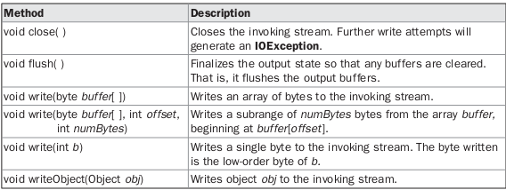
Methods Defined by ObjectOutput

Slide 45
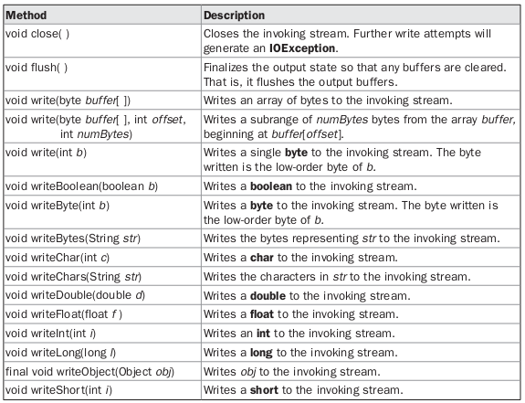
Methods Defined by ObjectOutputStream

Slide 46
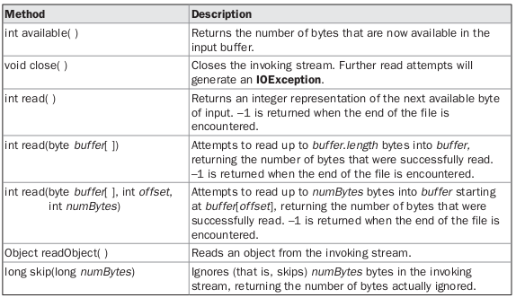
Methods Defined by ObjectInput

Slide 47
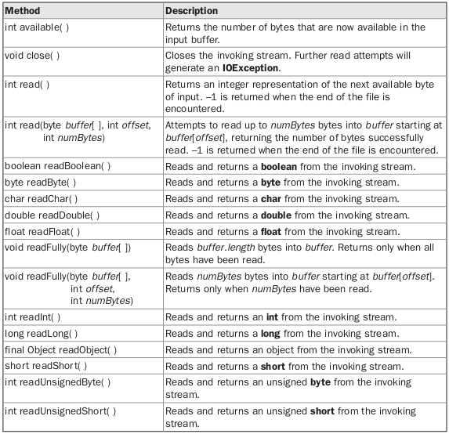
Methods Defined by ObjectInputStream

Slide 48
Serialization Example
class MyClass implements Serializable
{
String s;
int i;
double d;
public MyClass(String s, int i, double d) {
this.s = s;
this.i = i;
this.d = d;
}
public String toString()
{
return "s=" + s + "; i=" + i + "; d=" + d;
}
}

Slide 49
import java.io.*;
public class SerializationDemo {
public static void main(String args[]) {
try {
MyClass object1 = new MyClass("Hello", -7, 2.7e10);
System.out.println("object1: " + object1);
FileOutputStream fos = new FileOutputStream("serial");
ObjectOutputStream oos = new ObjectOutputStream(fos);
oos.writeObject(object1);
oos.flush();
oos.close();
}
catch(IOException e) {
System.out.println("Exception during serialization: " + e);
System.exit(0);
}

Slide 50
// Object deserialization
try {
MyClass object2;
FileInputStream fis = new FileInputStream("serial");
ObjectInputStream ois = new ObjectInputStream(fis);
object2 = (MyClass)ois.readObject();
ois.close();
System.out.println("object2: " + object2);
}
catch(Exception e) {
System.out.println("Exception during deserialization: " + e);
System.exit(0);
}
}
}

